Slide 1
Pattern Extraction
Stauffer Guy-Raphaël and Chevalley Gibran

Slide 2


Previous work

Slide 3
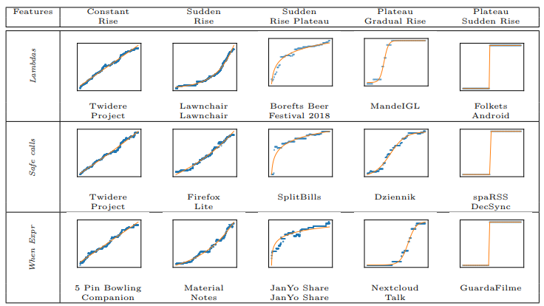
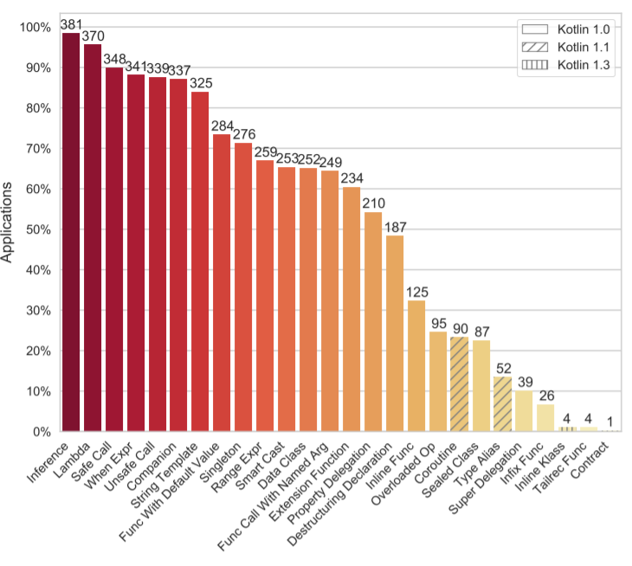
Previous work

Slide 4



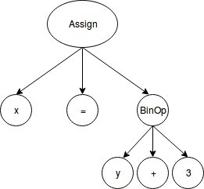
Project progression
AST

Slide 5
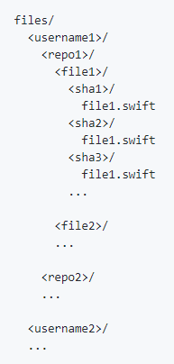

Github exploration
git clone https://github.com/Alamofire/Alamofire
GET https://api.github.com/search/repositories
?q=language:Swift&sort=stars&order=desc

Slide 6
Github exploration
apple/
swift/
0000_Main.swift/
3ac8b92fb595d54b365dee885885e3d7a22c7649/
Main.swift
0453335d5e47781fdd788299920dd380cc9155ef/
Main.swift
…
0001_Requires.swift/
...
Alamofire/
Alamofire/
0000_ContentView.swift/
603defe1fe8ba465da412767fc45e68edac9bc0a/
ContentView.swift
…
0001_DispatchQueue+Alamofire.swift/
…
…

Slide 7





Encountered problems
Renamed files in commit history
Syntax error according to swift-ast
Checkout commits

Slide 8
Retroactive modeling
extension Book: CustomStringConvertible {
var textDescription: String {
return title
}
}

Slide 9
Bounded polymorphism
extension Array where Element: Fullynamed {
func filterWithname(name: String) -> [Element] {
return self.filter { (item) -> Bool in
return item.fullname == name
}
}
}

Slide 10
Optional chaining
let john = Person()
john.residence?.address = someAddress
john.residence?.address.street? = "Bellevue"

Slide 11
Counted features in AST
Protocol declaration
Class declaration
Struct declaration
Retroactive modeling
Protocol extension
Protocol with associated datatype
Bounded polymorphism
Optional chaining
Optionals
Inline functions
Closure
Infered types
Variable declaration
Constant declaration

Slide 12



Project scope
+
1
Downloads Github projects
Extracts patterns
Ouputs statistics
Statistics analysis

Slide 13
Sources
Mateus, Bruno Góis, et Matias Martinez. « On the Adoption, Usage and Evolution of Kotlin Features on Android Development ». ArXiv:1907.09003 [Cs], 20 janvier 2020. http://arxiv.org/abs/1907.09003.

